Slide 1
Module 2 Multidimensional data representation and manipulation
Lesson 4: Microsoft MDX Statements
Notes:
Welcome to Lesson 4 of Module 2, Part 2 on Multidimensional data representation and manipulation
This lecture shows simple examples of the Microsoft Multidimensional Expressions (MDX) language.
Opening question:
Why is Microsoft MDX statements not directly used as much as indirectly via a visual tool?
What are some complicating parts of MDX statements?

Slide 2
Lesson Objectives
Explain simple MDX statements
Compare and contrast MDX and SQL
Gain insight into MDX complexity
Notes:
Objectives:
Grasp impact of MDX
Explain basic elements of MDX statements
Gain insight into the complexity of MDX expressions (Microsoft language)
Compare and contrast MDX to SQL

Slide 3
SQL Versus MDX
Table result for SQL SELECT statement
Data cube result for MDX SELECT statement
Different mathematical approaches for manipulating tables and data cubes

Slide 4
Comparison of Clauses
 | Language
Clause | SQL | MDX
SELECT | List of columns | List of axis dimensions (source cube cells)
FROM | List of tables | Cube name
WHERE | Conditions restricting rows | Restriction to a combination of dimension members (result cube cells)
Notes:
Fundamental difference:
SQL SELECT generates a 2 dimensional table
MDX SELECT generates m-dimensional cube possibly with summary calculations
MDX can support up to 128 axes.
X-axis is the 0-axis (the syntax could be “ON AXIS(0)”, “ON 0” or “ON COLUMNS”)
Y-axis is the 1-axis, Z-axis is the 2-axis … etc
The aliases for the first 5 axes are: COLUMNS, ROWS, PAGES, SECTIONS, and CHAPTERS
The axes must be used in the same order.
Every axis should select members from the same dimension.
Only 1 cube as the data source
MDX
Source cube cells in SELECT; can list subset of dimension member values
Result cube cells in WHERE: dimensions must be different than axis dimensions
Data source (cube) in FROM

Slide 5
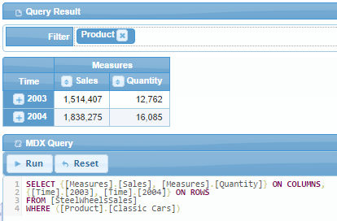
Example MDX Statement and Result
Notes:
Snapshot from Pivot4J
Time is the dimension on the rows. 2003 and 2004 are the year members on the rows.
Sales and Quantity are on the columns
The numbers (in black) inside the cells are the measures
Cells show sales and quantity for classic cars
WHERE clause
Restricts cube calculations to classic cars.
Dimensions in the WHERE clause must be different than the SELECT clause
WHERE condition is known as a slicer condition
If no measures appear in the SELECT list (dimension axes), the default measure is shown in the cells.

Slide 6
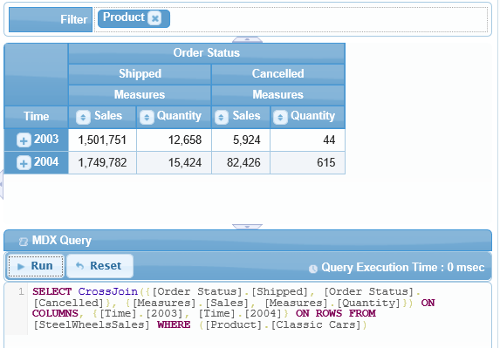
CrossJoin Operation
Notes:
The result of the previous MDX query.
Order Status is among the dimensions.
Sales and Quantity values are shown for “Shipped” and “Cancelled” only
Shipped and Cancelled are not exhaustive so some part of sales and quantity are not allocated.

Slide 7
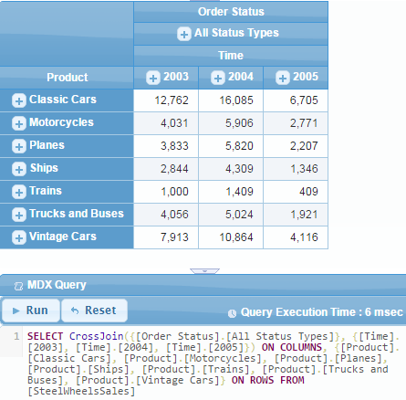
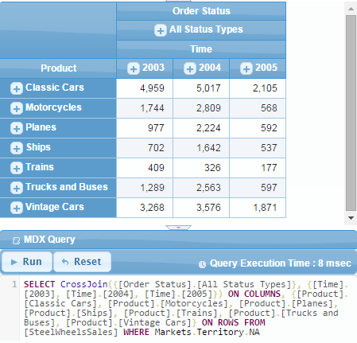
Slicer Comparison Examples
Notes:
Example showing the impact of a slicer condition. The data cube on the right has a WHERE condition to limit the calculated results to the North American member in the territory attribute of the Markets dimension. The Sales values in the cells are smaller because of the slicer condition. For example, the sales of classic cars in 2003 is 4,959 for North America, but 12,762 for all territories in 2003. Also depicts multiple dimensions on the columns dimension and the usage of the default measure (Sales), not shown in either query axis.

Slide 8
Summary
Similar syntax as SQL SELECT statement
Axes specified in SELECT clause
Crossjoin operator to combine dimensions on axis
Slicer conditions specified in the WHERE clause
Tedious and complex language
Notes:
Similar syntax as SQL SELECT
SELECT
FROM
WHERE
Manipulate cubes not tables
Axes
COLUMNS
ROWS
List dimensions to specify on axis
Use cross join operator to combine more than one axis on a dimension
Slicer dimensions
- Cannot be the same as axis dimensions

